Slide 1
Object Oriented Analysis and Design:
Introduction to the Case Study
Vending Machine Control System (VMCS) Computer Simulation
Heng Boon Kui
boonkui.heng@nus.edu.sg
Total Slides : 16

Slide 2

Project Strategy – Phase 1
Design and implementation of a Vending Machine Control System (VMCS) computer simulation that:
  Will run as a standalone Windows application on a standard Pentium PC
  But will provide all the necessary vending functions that are required by the real Vimto 45 drinks dispensing machine
This is the part of the project that you will be working on

Slide 3

Project Strategy – Phase 2
Modification of the VMCS computer simulation software so that:
  It will run on the internal processor of the Vimto 45 drinks dispensing machine
  It will will provide all the functionality necessary to control the real vending machine.
You are not doing this part of the project

Slide 4
Aim and Objectives of Phase 1
To enable the Vimto Soft Drinks Company management to confirm their requirements for the system functionality, including the user interface
For the software developers to demonstrate the adequacy of their implementation of the core functionality
To minimise the effort expended in Phase 2, the Phase 1 software should be developed in such a way that minimal changes are required to modify it to meet the requirements of Phase 2

Slide 5
Summary of Users
Users acting as customers of the vending machine, who would be members of the general public
Users acting as the vending machine maintainer
Users acting as controllers of the overall simulation of the VMCS
There will only be one user of the VMCS computer simulation at any time
The user should be able to play more than one role while using the system

Slide 6
Summary of System Functions - 1
Acceptance/rejection and cumulative totaling of coins entered by customers
Dispensing of a drinks can of a selected brand to the customer
Indication of whether the brands are available (or whether they are out-of stock)
Dispensing of change to customers
Ability to terminate the purchase

Slide 7
Summary of System Functions - 2
Displaying of requested information to the vending machine maintainer
Setting of new prices for drinks brands by the vending machine maintainer
Issue of all the coins held within machine to the maintainer
Simulated user interfaces for the customer and maintainer
An additional user interface to allow:
  the vending machine state to be monitored
  the stocks levels of coins and drinks cans held to be changed

Slide 8
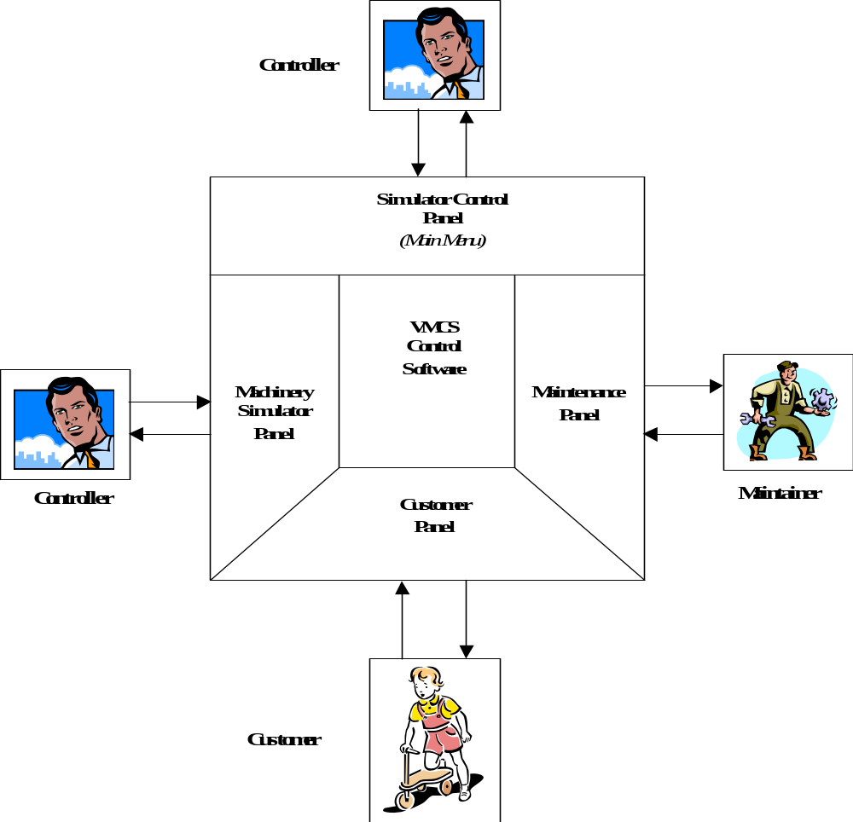
System Overview

Slide 9
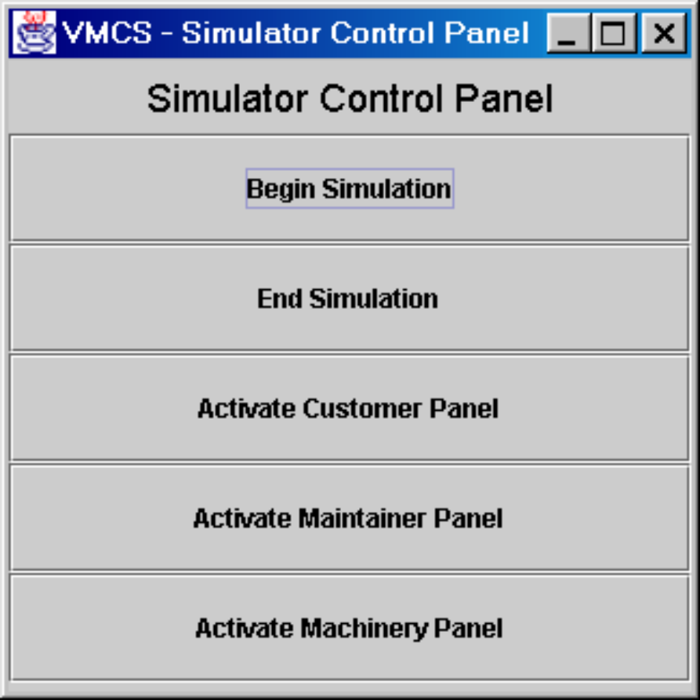
Simulator Control Panel – The Main Menu
Panel is displayed when application is run
Press Begin button to:
  Initialise the simulation from an Input File
  Activate the other buttons of the panel
Press Activate buttons to display each user interface panel
Press End button to:
  Save the current state of the simulation to the Input File
  Exit the application

Slide 10
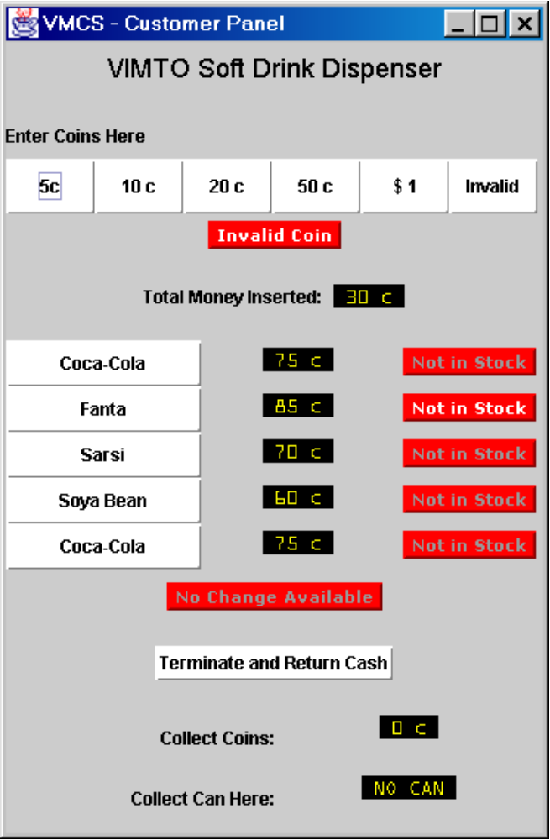
Customer Panel
Start by selecting a drink from those in-stock
Then enter coins:
  Total amount entered is displayed
  Invalid coins are displayed
When enough money has been entered:
  Dispense the drink
  Give the change
Before the drink has been issued, the purchase can be terminated

Slide 11
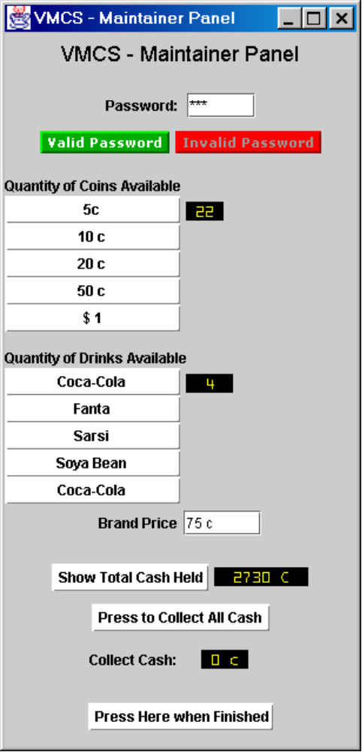
Maintenance Panel
Start by entering the correct password
  Valid or Invalid Password is displayed
  The password is fixed
  The rest of the panel is then activated
  The machine door is then un-locked
The following will then be available:
  View coin stocks
  View drinks can stocks and prices
  Change prices of brands
  View total amount of cash held
  Issue all cash held to the maintainer
End by pressing the Finish button – the door must be locked

Slide 12
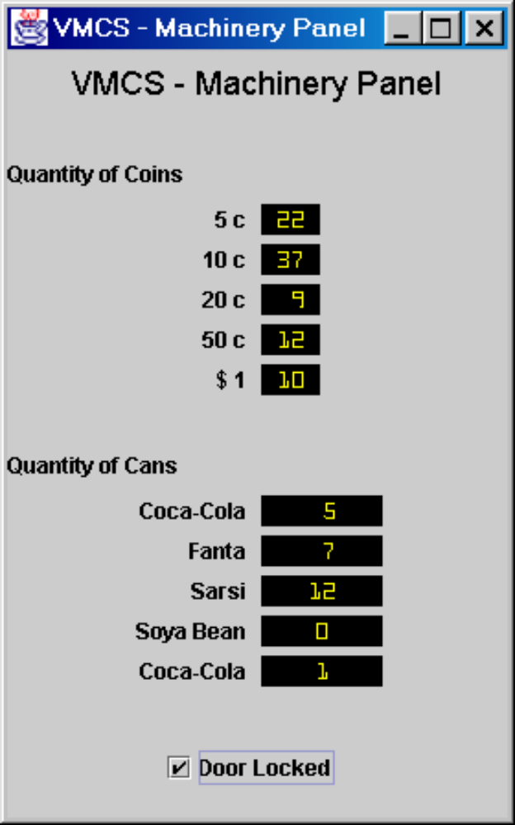
Machinery Simulator Panel
Panel is activated only when the door is unlocked
  When the door is locked, data can only be viewed
  When the door is unlocked, data can be viewed and changed
Coin stocks of each denomination can be viewed and changed
Can stocks of each brand can be viewed and changed
The door can be locked

Slide 13

Faults
In the real vending machine, when dispensing drinks or giving change, a fault might occur causing cans or coins to get stuck in the machine, preventing the customer transaction from being completed
The handling of such faults must be simulated in Phase 1. If a fault occurs then:
  If the can has not been dispensed, a refund will be given
  All customer transactions will be suspended until the maintainer has successfully entered and exited from the system

Slide 14


Concurrent Use of Customer and Maintainer
If the maintainer successfully enters the system then:
  The current customer transaction will be terminated
  If the drink has not yet been dispensed, a refund will be given
  All further customer transactions will be suspended until the maintainer has successfully exited from the system

Slide 15

Giving Change
If less money than a defined minimum is currently held by the machine, then:
  No change available should be indicated on the customer panel
If less money is currently held by the machine than is required to be issued as change, then:
  The largest amount of change, less than the amount requested, should be issued to the customer
  No change available should be indicated on the customer panel
The No change available caption should be removed when either:
  More change is loaded or
  Change is successfully issued to a customer

Slide 16

Development Constraints
Analysis and Design Method: RUP
Programming Language: Java
Hardware: PC
Operating System: Windows XP

